Slide 1
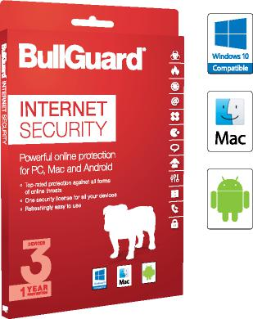
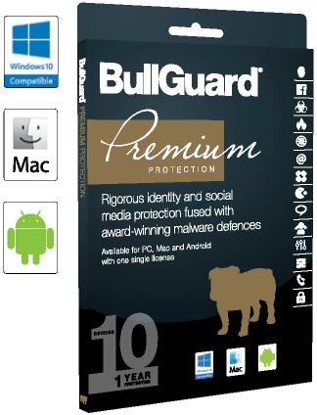
Quick Reference Guide
2017 Products with Multi-Device Licensing
 | BullGuard Internet Security The world’s favorite Internet Security solution is now multi-platform to keep users safe, whatever devices they use. MDL licensing for 3 devices. Protects PCs, Macs and Android devices with a single license. Robust, layered protection against all forms of viruses, spyware, malware and other online threats. Highly rated firewall that protects against network attacks and keeps out intruders. Powerful Parental Control helps to protect kids from cyber-bullying and predators.
BullGuard Premium Protection
Rigorous identity and social media protection fused with award-winning malware defenses is now multi-device and cross-platform.
MDL licensing for 10 devices.
Protects PCs, Macs and Android devices with a single license.
Social Media Protection safeguards children on social media networks.
Powerful Parental Control helps to protect kids from cyber-bullying and predators.
Robust, layered protection against all forms of viruses, spyware, malware and other online threats.
Highly rated firewall that protects against network attacks and keeps out intruders.
So what’s new? | Our popular Internet Security (IS) and Premium Protection (BPP) products are more effective than ever at keeping your customers safe online.
MDL: With the same license, users will be able to use their IS or BPP program on any Windows application, as well as their Macs and their Android tablets and smartphones.
The feature mix varies across the platforms, to see what is covered on which system see the table on the reverse.
Online Backup: In place of the old online drive, our new products feature seamless integration with popular applications, Google Drive and One Drive backup, as well as backup to Dropbox. It’s easy to use, easy to view and even allows for synchronized backup so stored files keep up with what your customers do on their devices.
Identity Protection* is provided by our partners, Experian, the global credit referencing agency. It’s a great feature which actively searches for your customer’s details being shared on the dark web.
Speed, efficiency and
performance is fully maximised and our programs are still light on system resources and beautifully easy to use.
* Identity Protection is available in: US, UK, Canada, Denmark, Germany, France, Ireland and Netherlands.

Slide 2
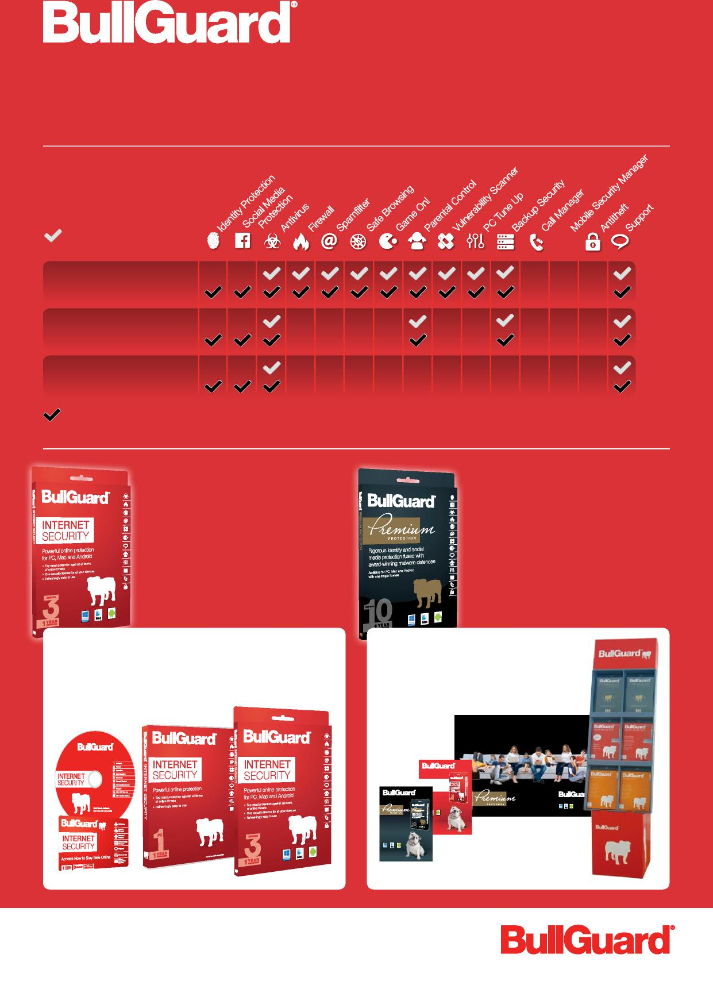
Quick Reference Guide
Award-winning, easy to use multi-platform
products for the home and small business user
BullGuard Internet Security MDL
Windows Features
Android Features
Mac Features
BullGuard Premium Protection MDL
Backup Security: for Windows encrypted backup with Dropbox, One Drive, Google Drive and owned storages (external HDDs, USBs, network storages) while for Android, encrypted backup for the small data (Contacts, Calendar, Messages).
BullGuard Internet Security License: 3 devices
Platforms: PC, Mac, Android Trial period: 60 days Languages: EN DK DE FR ES SWE NO NL IT
Free automatic upgrades
BullGuard Premium Protection
License: 10 devices
Platforms: PC, Mac, Android
Trial period: 30 days
Languages: EN DK DE FR ES
SWE NO NL IT
Free automatic upgrades
Flexible Purchase and Resell Options
ESD for pre-install
Softbox for attachment to approved devices
Retail boxes for standalone sale
Merchandise Kits
Sales leaflets, product units and in-store displays inform your customers and help you sell.
Complete online protection for the whole family!
INTERNET URITY
Top rated internet security plus 24/7 Identity &
Social Media protection bullguard.com for up to 10 x devices
online n for PC, Android
BG-2016-MDL-QSG-UK
Rigorous identity and social media protection fused with award-winning malware defences

